Slide 1
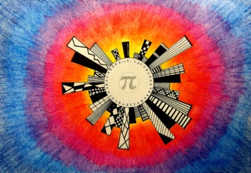
NAAC Accredited Best Placements Merit Positions in University
Institute of Science And Research
IPS Academy, Indore
Department of Mathematics
Organizing a Guest Lecture on Topic
“Applications of Mathematics in Daily Life”
..............................................................
Resource Person
Dr. Naresh Birwal
Department of Mathematics
Govt. College, Sanwer (M.P.)
...................................................................................
Date: 14 March 2023 Time: 11:15 AM Onwards
Convener: Dr. Amita Joshi , Department of Mathematics
Email : amitajoshi@ipsacademy.org
Online Platform: Google Meet
link: https://meet.google.com/wbj-rnfk-rji

