Slide 2
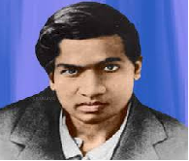
NAAC Accredited Best Placements Merit Positions in University
Institute of Science And Research
Organizing
Guest Lecture & Quiz Competition
on the occasion of
“Mathematics Day”
..............................................................
Eminent Speaker
Dr. S.K. Bandi
Professor Emeritus , IPS Academy, Indore (M.P.)
...................................................................................
Date: 22 December 2020 Time : 3:00 -4:00 pm

Slide 5
Welcome Speech
Dr. Pradeep K. Joshi

Slide 6
Department of Mathematics
Institute of Science and Research
Celebrating
“National Mathematical Day”
Short Video Film
It will be shown in the Program.

Slide 7
Department of Mathematics
Institute of Science and Research
Expert Lecture
Dr. S.K. Bandi
Professor Emeritus , IPS Academy, Indore .

Slide 9
Vote of Thanks
Dr.Amita Joshi

Slide 10
National Antham

