Slide 1
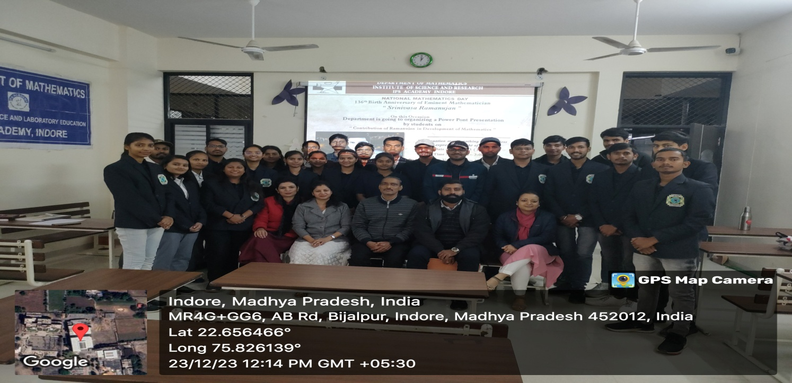
PRESENTATION BY STUDENTS ON NATIONAL MATHEMATICS DAY- 23/12/2023

